Slide 1
The Unknown Sarov
Выполнила: ученица 6 «Б» класса
Пешехонова Татьяна
Руководитель: Гришунина Валентина Петровна
Преподаватель МБОУ Гимназия 2
Sarov
2022

Slide 2
We say: «Petals»
Why do we say "Petals"? These twelve—storeyed houses were built in the late seventies - early eighties of the twentieth century.
The houses are called ''Petals'' even in the advertisements for the sale of apartments.

Slide 3
We say: «Pitsunda»
Why do we say "Pitsunda“? Pitsunda was a popular Abkhazian resort in Soviet times.
In Sarov, there was a narcological dispensary at the address Zernova 43.
The patients were dressed in pajamas and squinted in the sun, they caused associations with the resort.

Slide 4
We say: «The Pool»
Why do we say: the "Pool“?
Not all residents of Sarov know that it is Borovoe Lake. Traditionally, the reservoir located along Bessarabenko Street is called the "Pool".

Slide 5
We say: «Red House»
Why do we say «The Red House”? There are a lot of houses of this colour but everyone knows this one.

Slide 6
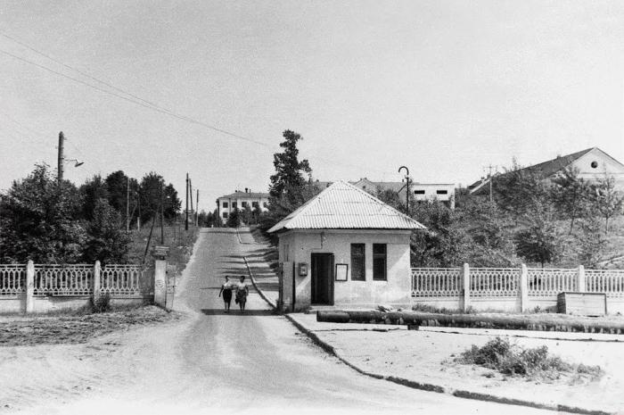
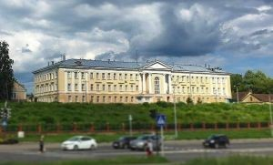
We say: «Maslikha»
Why do we say "Maslikha“? This name was first mentioned in monastic records in 1796.

Slide 7
We say: «Georgian»
Why do we say: "Georgian" or “ The Georgian Military road“? Our road
No. 123 connects Mira Avenue and Komsomolskaya Square. It perfectly corresponds to its folk name: on the one side there is the river Satis, and on the other – the hills.

Slide 8
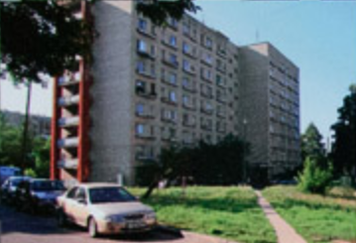
We say: «The Merry Widows»
Why do we say : "The Merry Widows“?
In the Soviet times, grandmothers who lost their husbands moved to live in the small rooms of these "little families", which were located on Bessarabenko Street.
(Women usually live longer than men.)

Slide 9
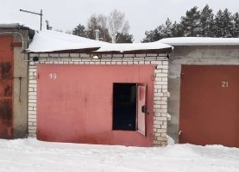
We say: “Dogman"
Why do we say "Dogman"?
Here, until the nineties of the twentieth century, the ATC nursery was located. “Four-legged police officers” were kept there. In the city newspapers you can see ads for the sale or purchase of garages "On the "Dog House"

Slide 10
We say: «Bastille»
Why do we say: "Bastille”?
After the construction in 1968-1969, three nine-storeyed houses on Shvernik Street towered over the low-rise buildings of Stalin and Khrushchev times as bastions of the fortress.

Slide 11
We say: «Arzamas 17»
Why do we say: "Arzamas 17“? Since 1966 to 1992, Sarov was named Arzamas -16.
It is interesting to know that in the city of Chelyabinsk-70 (now Snezhinsk), a similar city-forming enterprise RVYATS-VNIITF consists of two design bureaus, but the cemetery of Snezhintsy is called “KB-3”.

Slide 12
Thanks for your attention!

Slide 13
Список использованной литературы
https://sarov.info/news/history/2019/09/12/bastilii.html
https://sarov.info/news/history/2019/10/31/veselye-vdovy.html
https://vsarov.ry/2019/07/ozero-borovoe-bassejn/
https://sarov.info/news/history/2019/11/20/lepestki.html
https://www.youtube.com/watch?v=ngNnhyqx1fA

